Slide 1
ENTERTAINER DATA ANALYSIS
Prepared by : Darshil Ashish Nanavati

Slide 2
INTRODUCTION
Entertainment is an excellent way to reduce stress and make life's challenges easier to tackle. The entertainment industry encompasses various segments, including film, television, radio, and print media. These segments offer a wide range of entertainment options such as movies, TV shows, radio shows, news, music, newspapers, magazines, and books. The entertainment industry is a group of sub-industries that provide entertainment services to the masses.
The entertainment industry is responsible for producing and distributing entertainment content that is enjoyed by millions of people worldwide. The industry includes mass media companies that manufacture, distribute, and control the distribution of entertainment content. These companies leverage technology to make entertainment content available to consumers via different platforms.
One of the benefits of the entertainment industry is that users can easily access information about their favorite entertainers through various channels, such as dashboards. These dashboards provide users with information about an entertainer's background, career achievements, and the number of awards they have won. This allows users to stay up-to-date with their favorite entertainers and to discover new artists and entertainers they may be interested in. Overall, the entertainment industry plays a crucial role in providing people with a means of relaxation and enjoyment, and it will continue to evolve and adapt to meet the changing needs of consumers.

Slide 3
GIVEN TASKS
Task #1 - In a word document write the process and data added to the current dataset. In addition, mention the theme on which you will be creating the dashboard.
Task #2 - You can add your data as per your convenience.
Task #3 – Do the data preparation part.
Task #4 – Build the dashboards.
Task #5 – Build a Storyline.

Slide 4
DATA PREPARATION AND DESCRIPTION
The data was divided into three parts: Entertainer Basic Info, Entertainer Breakthrough Info, and Entertainer Last Work Info.
The three parts were merged into a single file called "Entertainer Final.
"The given data was not sufficient for analysis, so more information needed to be added.
The number of awards and nominees won by the entertainers, as well as their awards from breakthrough performances, were added to the data.
The data included both numeric and alphabetic values.
Additional data was obtained from IMDb's official website.
The source of the data was IMDb.

Slide 5
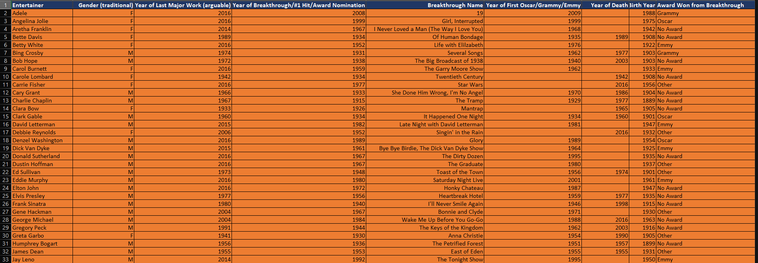
FINAL MERGED DATA SET

Slide 6
COLOUMN NAME AND DESCRIPTION
Entertainer
Profession
Gender (traditional)
Birth Year
Year of Breakthrough/
#1 hit/Award Nomination
Breakthrough Name
Year of First Oscar/Grammy/Emmy
Year of Last Major Work (arguable)
Year of Death
Total Awards won
Total Nominees
Oscar won
Grammy won
Emmy won
No. of other awards won
Award won from Breakthrough
Name of entertainer.
Category of entertainer (actor or singer). Gender of entertainer
Birth year of entertainer
Year of breakthrough of entertainer.
Breakthrough means super hit or career changing performance by entertainer.
Name of breakthrough. It can be any musical album, TV shows, movie etc.
Year of first mega award won by entertainer.
Last appearance of that entertainer. Death year of that entertainer (if they die).
Total number of awards won by entertainer.
Total number of nominees by entertainer for whichever award they were candidate.
Number of total Oscars won by entertainer.
Number of total Grammies won by entertainer
. Number of total Emmieswon by entertainer.
Number of total other awards won by entertainer.
Entertainer has award from breakthrough or not? If they have mean award I

Slide 7



TOOLS USED

Slide 8
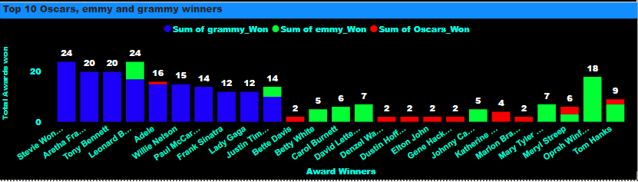
VISUALS
Top 10 award winners and nominees based on their Gender and Profession.

Slide 9
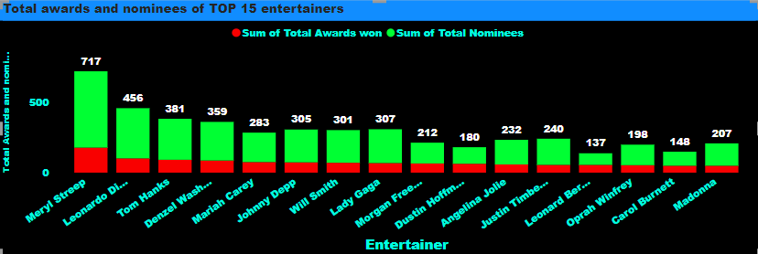
VISUALS
This graph gives us insights about top 15 entertainers with most awards and nominations and you can see red bar shows us the sum of total awards won by and individual artist and green bar gives us information about his/her total nominations.

Slide 10
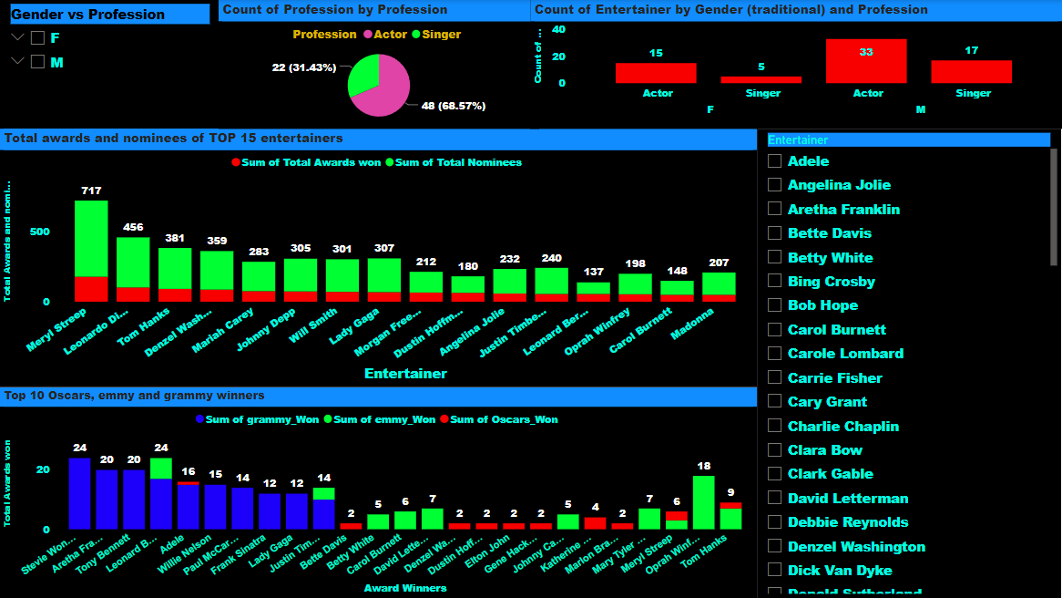
COMPLETE DASHBOARD
1. Here is the complete look of the dashboard where on the top left corner I have added gender vs profession slicers which will filter out all the entertainers based on their gender and profession.
2. just next to the Gender vs profession slicers we have pie chart which gives us insights into entertainer’s profession, here 68.57% of entertainers are actors and 31.43% are singers.
3. top Right corner I have added stacked column chart that gives us information about the profession of entertainers based on their Gender
4. The two stacked column chart as explained earlier gives us in-depth information about the entertainers awards and nomination.
5. Finally at the bottom right corner we have individual artists where we can filter out their individual performance.

Slide 11
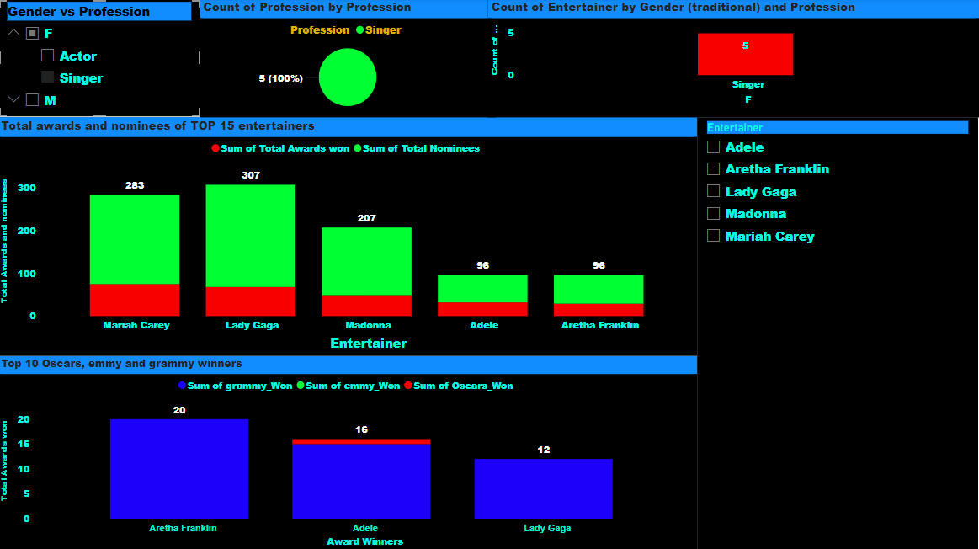
DASHBOARD WITH SOME FILTERED OPTIONS
Here I have selected Female Singers as my filter this gave us information about all the singers who have won total number of awards, their nomination including all the major awards won

Slide 12
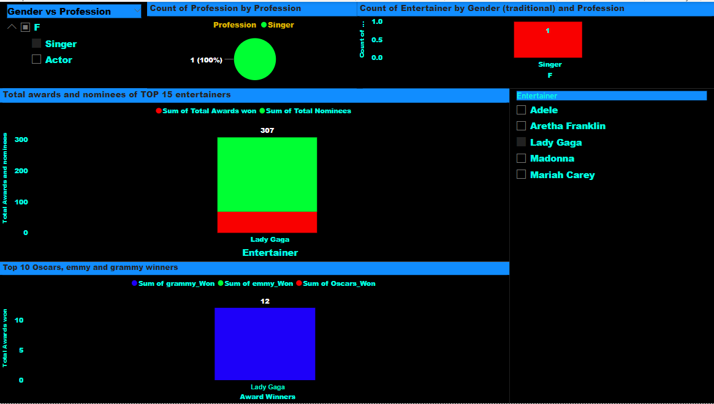
DASHBOARD WITH SOME FILTERED OPTIONS
Further filtering when I selected a particular singer like lady gaga, we can see that she had total 307 nomination and awards won, but out of three major awards she has won only 16 grammy awards.

Slide 13

FINAL ANANLYSIS
➢Mery Streep is the best entertainer with 177 total wins including 3Oscars and 3Emmies also she has 540 nominees.
➢Most of the entertainers are from actors category.
➢Katherine Hepburn has highest Oscars(4).
➢Orpah Winfrey has highest Emmie's(18).
➢Stevie Wonder has highest Grammies(24).
➢Stevie Wonder has highest mega awards (24Grammies+1Oscar).
➢There are very less entertainers who won awards from their breakthrough.

